Slide 1

Regression: Chris Paul
By Avery Peterson April 20th, 2022

Slide 2


Objective

Slide 3

Objective
Motivation: Chris Paul wants to improve his offensive potential during the regular season
Objective: Create an simple, interpretable set of recommendations to improve his points scored per game

Slide 4
Methodology

Slide 5

Data Set
End of game statistics for entire career
Omitted redundant/null data points (ex: FG%, FTA%, inactive)
Omitted statistically insignificant data (Def Reb, STL, TOV)
Focused on in-game statistics
Most actionable
Independent variables

Slide 6
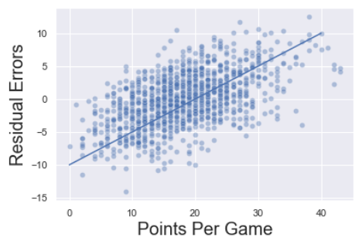
Model
Used a Linear Regression Model
✅ Simple
✅ Interpretable Coefficients
✅ Good Predictability

Slide 7
Results

Slide 8
Model Results
R^2 = 0.699 (Model Accuracy)
Model accounts for 70% of the variance between the dependent and independent variables
Score of 1 → perfect explanation
RMSE = 9.087 MAE = 7.362 (Error Mitigation)
This model accurately predicts Points Per Game give-or-take 7-9 points depending on the metric you use
Lower Score → less errors in model

Slide 9
Top Stats ( * are significant stats)
Game Statistic | Coefficient | Interpretation Relative to Points
Field Goal Attempts | 1.12 | Increase points by 1.12 for every shot
Three Point Attempts | 0.394* | Increase points by 0.394 for every three point shot
Free Throw Attempts | 0.81* | Increase points by 0.81 for every free throw
Offensive Rebounds | -0.915* | Decrease points by 0.915 for every offensive rebound
Assists | 0.039 | Increase points by 0.039 for every assist
Blocks | 0.572 | Increase points by 0.572 for every block
Turnovers | 0.098 | Increase points by 0.098 for every turnover
Personal Fouls | -0.169 | Decrease points by 0.169 for every personal foul

Slide 10
Conclusion

Slide 11
Key Takeaways
Take more shots, specifically mid-range, layups, and free throws (not surprisingly).
Leave offensive rebounding to your forwards. Don’t crash the boards on offense (CP is a smaller, true point guard).
Keep positioning to perimeter / top of the key. CP is known for his mid range, and as a smaller guard, it’s harder to create shots starting under the basket.

Slide 12
Future Work

Slide 13
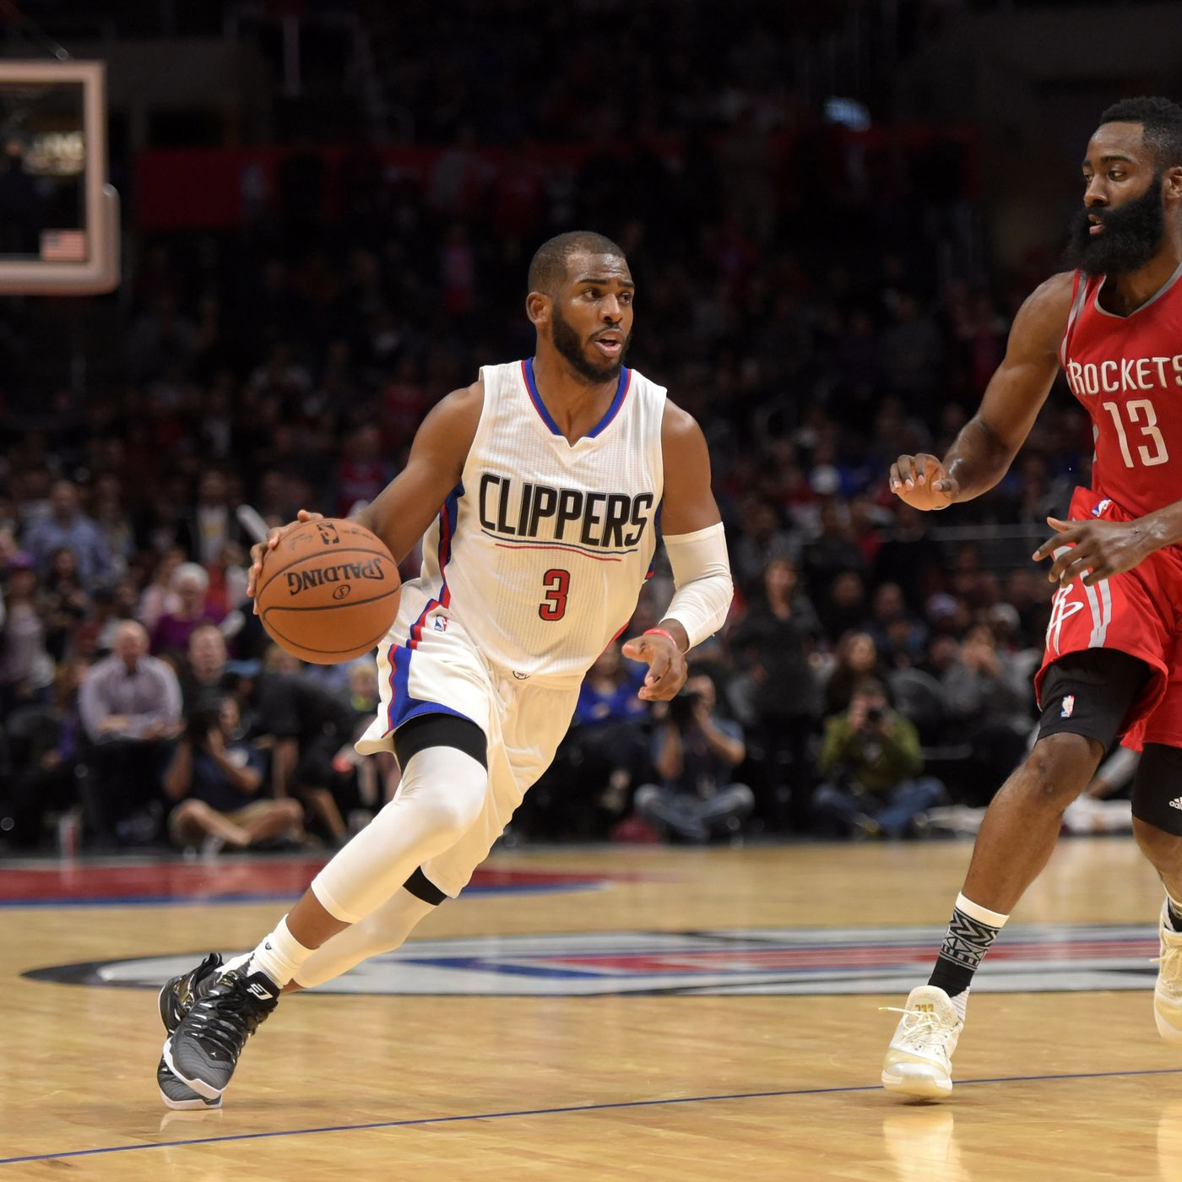
Future Work
Opponent data to determine to determine best/worst performance teams
Stats as a time series for data trends
Incorporate team per-game stats and individual stats

Slide 14
Questions?

Slide 15
Appendix

Slide 16
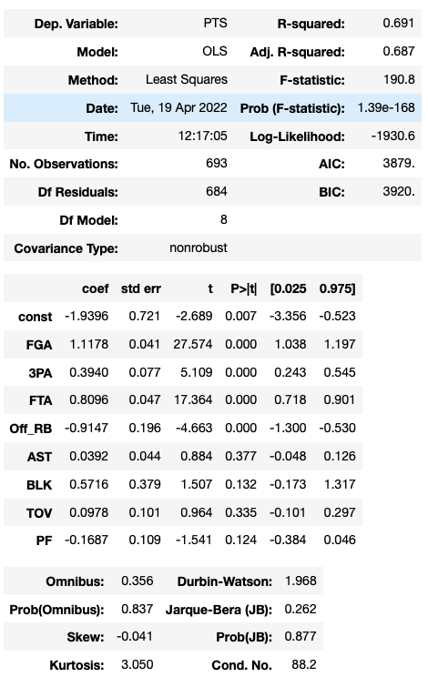
Regression Results

Slide 17
Residual Graph

